Slide 1
Running a small business
Maths in the workplace

Slide 2
How our teaching resources are designed for the classroom

Slide 3
I can understand how maths is used by independent business owners.

Slide 4
Percentage profit is the increase when referencing something that is sold for more than the cost price given as a percentage of the original amount.
An average is a single number expressing the central or typical value in a set of data; the mode, the median, and the mean.

Slide 5

Running a small business
Profit in percentages
Tracking performance

Slide 6
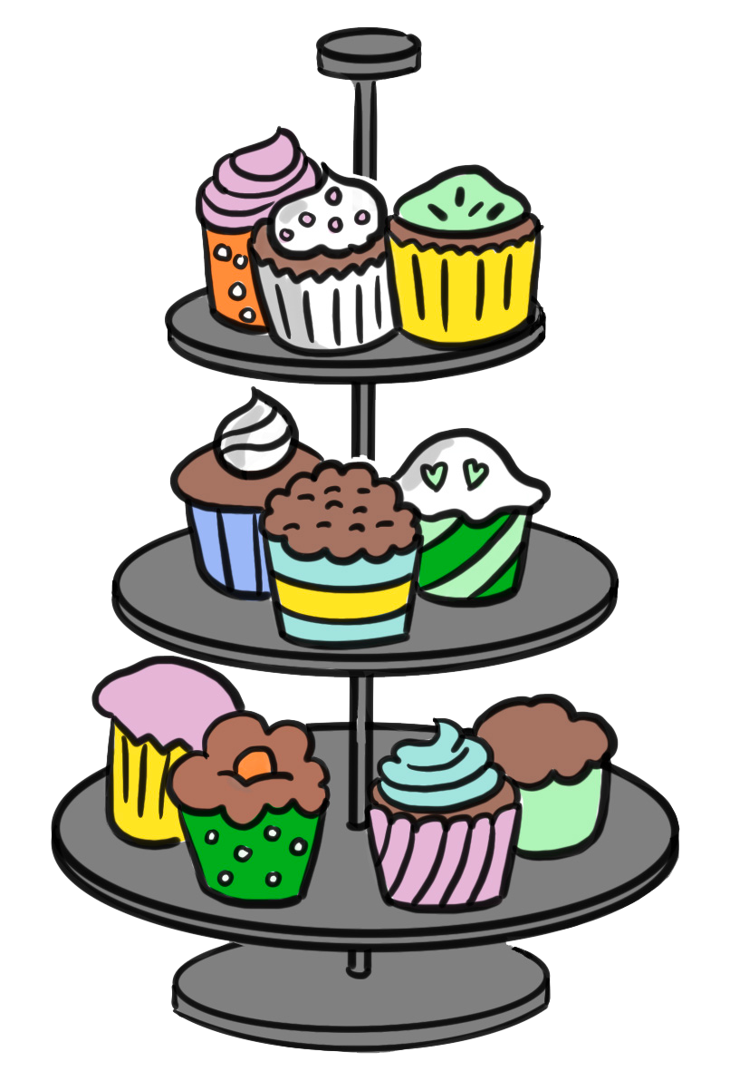




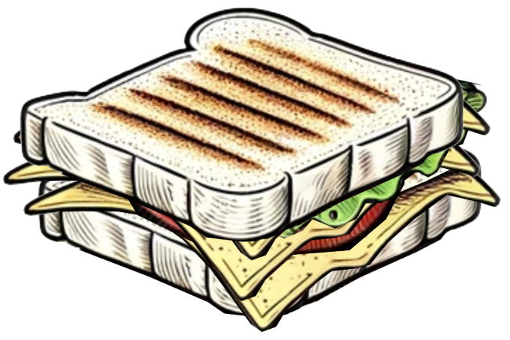
Profit in percentages
Alex and Izzy have opened their first business, a cafe. Here are their first three years of results.
 | Gross profit | Revenue
Year one | £24 000 | £60 000
Year two | £28 000 | £80 000
Year three | £30 000 | £120 000

Slide 7
Profit in percentages
Some terminology:
 | Gross profit | Revenue
Year one | £24 000 | £60 000
Year two | £28 000 | £80 000
Year three | £30 000 | £120 000
Revenue is the income into the business, i.e. the money that goes in the till from sales. If customers buy 300 coffees a week at £3 each that is £900 in revenue.

Slide 8
Profit in percentages
Some terminology:
 | Gross profit | Revenue
Year one | £24 000 | £60 000
Year two | £28 000 | £80 000
Year three | £30 000 | £120 000
Gross profit is the total revenue minus the cost of the goods that were sold. E.g. If the milk and beans used to make a cup of coffee cost £1 and we sell that cup for £3 that is a gross profit of £2 per cup.

Slide 9
Profit in percentages
Some terminology:
 | Gross profit | Revenue
Year one | £24 000 | £60 000
Year two | £28 000 | £80 000
Year three | £30 000 | £120 000
Gross profit only includes the cost of the goods, the variable costs. i.e. As the number of cups of coffee varies, the amount of beans and milk needed varies. Gross profit does not include fixed costs like buildings and bills.

Slide 10
Profit in percentages
Is Alex and Izzy’s business doing well?
 | Gross profit | Revenue
Year one | £24 000 | £60 000
Year two | £28 000 | £80 000
Year three | £30 000 | £120 000

Slide 11
Profit in percentages
Is Alex and Izzy’s business doing well?
 | Gross profit | Revenue
Year one | £24 000 | £60 000
Year two | £28 000 | £80 000
Year three | £30 000 | £120 000
Both gross profit and revenue are up so it looks like the business is going well.
However, proportion plays an important part in understanding if a business is doing well; if it is being efficient.

Slide 12

Profit in percentages
Is Alex and Izzy’s business doing well?
 | Gross profit | Revenue
Year one | £24 000 | £60 000
Year two | £28 000 | £80 000
Year three | £30 000 | £120 000
×2
To get from £60 000 in revenue to £120 000 Alex and Izzy had to be twice as active. They will have had to make twice as many coffees, cakes and sandwiches. They may have had to employ more people or invest in bigger kitchen equipment.

Slide 13
Profit in percentages
Is Alex and Izzy’s business doing well?
Gross profit | Revenue
£24 000 | £60 000
£28 000 | £80 000
£30 000 | £120 000
×1.25
×2
This doubling of effort only resulted in a 25% increase in profit.
If you were in a part-time job and your employer said, “I will pay you 25% more if you work twice as hard.” I suspect you would politely decline.

Slide 14
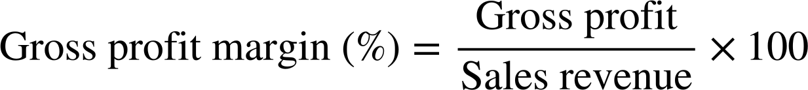
Profit in percentages
To understand their efficiency between revenue and profit, businesses add a third column to results like these.
 | Gross profit | Revenue
Year one | £24 000 | £60 000
Year two | £28 000 | £80 000
Year three | £30 000 | £120 000
 | Gross profit | Revenue | Gross profit margin
Year one | £24 000 | £60 000
Year two | £28 000 | £80 000
Year three | £30 000 | £120 000
Gross profit margin is calculated using a formula:

Slide 15
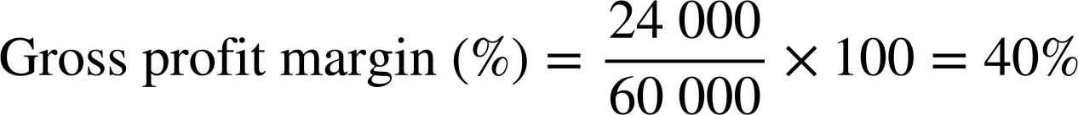
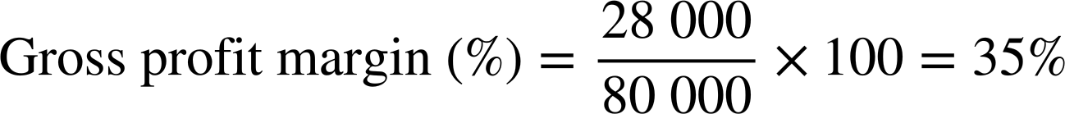
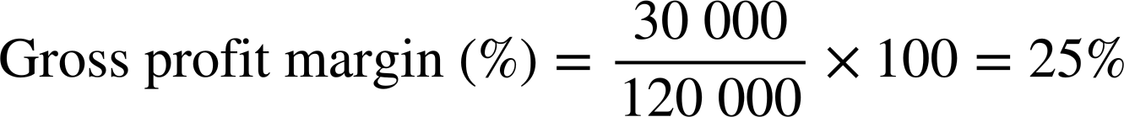
Profit in percentages
To understand their efficiency between revenue and profit, businesses add a third column to results like these.
 | Gross profit | Revenue
Year one | £24 000 | £60 000
Year two | £28 000 | £80 000
Year three | £30 000 | £120 000
 | Gross profit | Revenue | Gross profit margin
Year one | £24 000 | £60 000
Year two | £28 000 | £80 000
Year three | £30 000 | £120 000
 | Gross profit | Revenue | Gross profit margin
Year one | £24 000 | £60 000 | 40%
Year two | £28 000 | £80 000
Year three | £30 000 | £120 000
 | Gross profit | Revenue | Gross profit margin
Year one | £24 000 | £60 000 | 40%
Year two | £28 000 | £80 000 | 35%
Year three | £30 000 | £120 000
 | Gross profit | Revenue | Gross profit margin
Year one | £24 000 | £60 000 | 40%
Year two | £28 000 | £80 000 | 35%
Year three | £30 000 | £120 000 | 25%
Year one:
Year two:
Year three:

Slide 16
Profit in percentages
If this pattern continues, margins might become so tight that their business is no longer viable.
 | Gross profit | Revenue | Gross profit margin
Year one | £24 000 | £60 000 | 40%
Year two | £28 000 | £80 000 | 35%
Year three | £30 000 | £120 000 | 25%
In their first year of trading 40% of their revenue was gross profit.
In their third year of trading only 25% of their revenue was gross profit.

Slide 17
Profit in percentages
Here are the results for year four and five. Calculate the gross profit margin for both years.
 | Gross profit | Revenue | Gross profit margin
Year one | £24 000 | £60 000 | 40%
Year two | £28 000 | £80 000 | 35%
Year three | £30 000 | £120 000 | 25%
Year four | £33 000 | £110 000
Year five | £40 000 | £120 000
 | Gross profit | Revenue | Gross profit margin
Year one | £24 000 | £60 000 | 40%
Year two | £28 000 | £80 000 | 35%
Year three | £30 000 | £120 000 | 25%
Year four | £33 000 | £110 000 | 30%
Year five | £40 000 | £120 000 | 33.3% (to 1 d.p.)

Slide 18
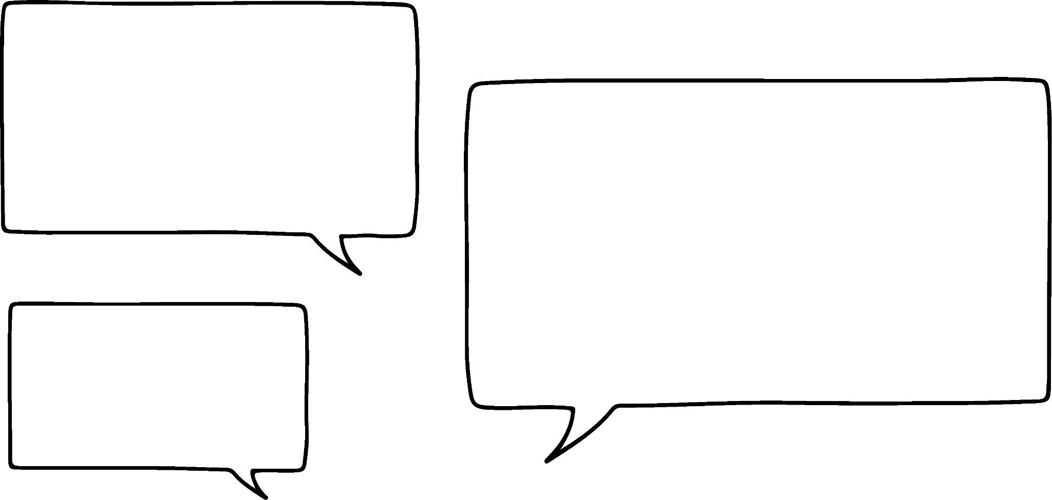
Profit in percentages
To ensure their profit margin at the end of the year is healthy, businesses set prices on individual items with a desired profit margin in mind.
I didn’t get our pricing right in the first three years Izzy. I dropped our prices, we sold more, but it eroded our profit margin.
That’s not a problem Alex. We know now. From here on we won’t sell any individual item for less than a 40% profit margin.

Slide 19
Profit in percentages
Gross profit margin per item can be calculated using a formula.
Alex and Izzy sell a cheese and tomato sandwich for £4. The ingredients cost £2.20
£1.80 is the cash gross profit they make from each sandwich,
£1.80 is the cash gross profit they make from each sandwich, and 45% is what proportion of the selling price this is.

Slide 20
Profit in percentages
Calculate the gross profit margin for each of these items.
Flapjack: Selling price £2, cost price £0.90
Coffee: Selling price £3, cost price £0.30
Goats’ cheese sandwich: Selling price £4.50, cost price £3
Advise Alex and Izzy of any items that aren’t making their 40% gross profit margin target.

Slide 21
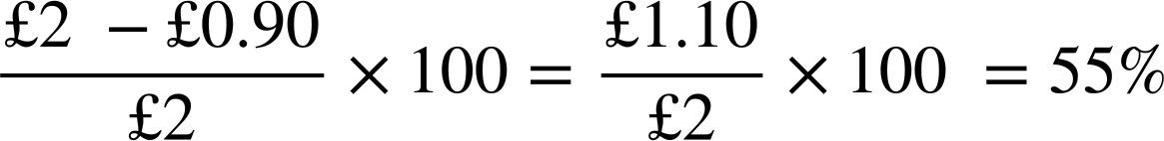
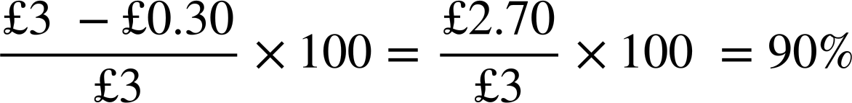
Profit in percentages
Calculate the gross profit margin for each of these items.
Flapjack: Selling price £2, cost price £0.90
Coffee has an especially high profit margin. Alex and Izzy want to sell more coffee than any other product!
Coffee: Selling price £3, cost price £0.30

Slide 22
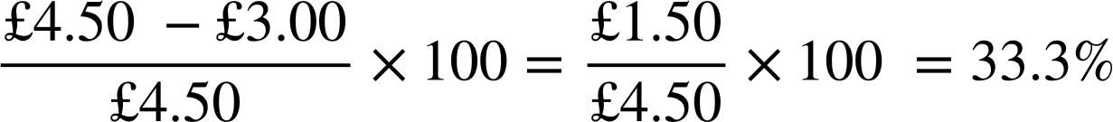
Profit in percentages
Calculate the gross profit margin for each of these items.
Goats’ cheese sandwich: Selling price £4.50, cost price £3
(to 1 d.p.)
Goats’ cheese sandwiches are not meeting the 40% profit margin target. Alex and Izzy need to either increase their price, find a way to reduce their cost price, or stop selling these sandwiches.

Slide 23
Profit in percentages
Percentage calculations enable small businesses to determine how to price their products.
Goats’ cheese sandwich:
Selling price: £5
Selling price:
Cost 60%
Profit margin 40%
Cost price £3
Selling price × 0.6 = £3
£5 is the minimum selling price Alex and Izzy should charge for a goats’ cheese sandwich.
therefore…
£3 ÷ 0.6 = Selling price
£3 ÷ 0.6 = £5

Slide 24
Profit in percentages
Alex and Izzy have to make a minimum 40% gross profit margin on these items. Calculate their minimum selling price.
Chicken mayo s’wich:
Cost price £2.40
£2.40 ÷ 0.6 = £4
Croissants:
Cost price £1.50
£1.50 ÷ 0.6 = £2.50
Shakes:
Cost price £1.15
£1.15 ÷ 0.6 = £1.92

Slide 25
Profit in percentages
Alex and Izzy have to make a minimum 40% gross profit margin on these items. Calculate their minimum selling price.
Chicken mayo s’wich:
Cost price £2.40
£2.40 ÷ 0.6 = £4
Croissants:
Cost price £1.50
£1.50 ÷ 0.6 = £2.50
Shakes:
Cost price £1.15
£1.15 ÷ 0.6 = £1.92
Alex and Izzy want to make minimum a 75% gross profit margin on cakes. Calculate their minimum selling price.
Lemon drizzle:
Cost price £0.30
£0.30 ÷ 0.25 = £1.20
Carrot cake:
Cost price £0.45
£0.45 ÷ 0.25 = £1.80
75% gross profit means 25% is cost price therefore…

Slide 26

Profit in percentages
Chicken mayo s’wich:
Cost price £2.40
£2.40 ÷ 0.6 = £4
Croissants:
Cost price £1.50
£1.50 ÷ 0.6 = £2.50
Shakes:
Cost price £1.15
£1.15 ÷ 0.6 = £1.92
Lemon drizzle:
Cost price £0.30
£0.30 ÷ 0.25 = £1.20
Carrot cake:
Cost price £0.45
£0.45 ÷ 0.25 = £1.80
I love maths but we sell almost a hundred products. Calculating minimum pricing is going to take hours!
That’s why most small businesses use spreadsheets. We should too!

Slide 27
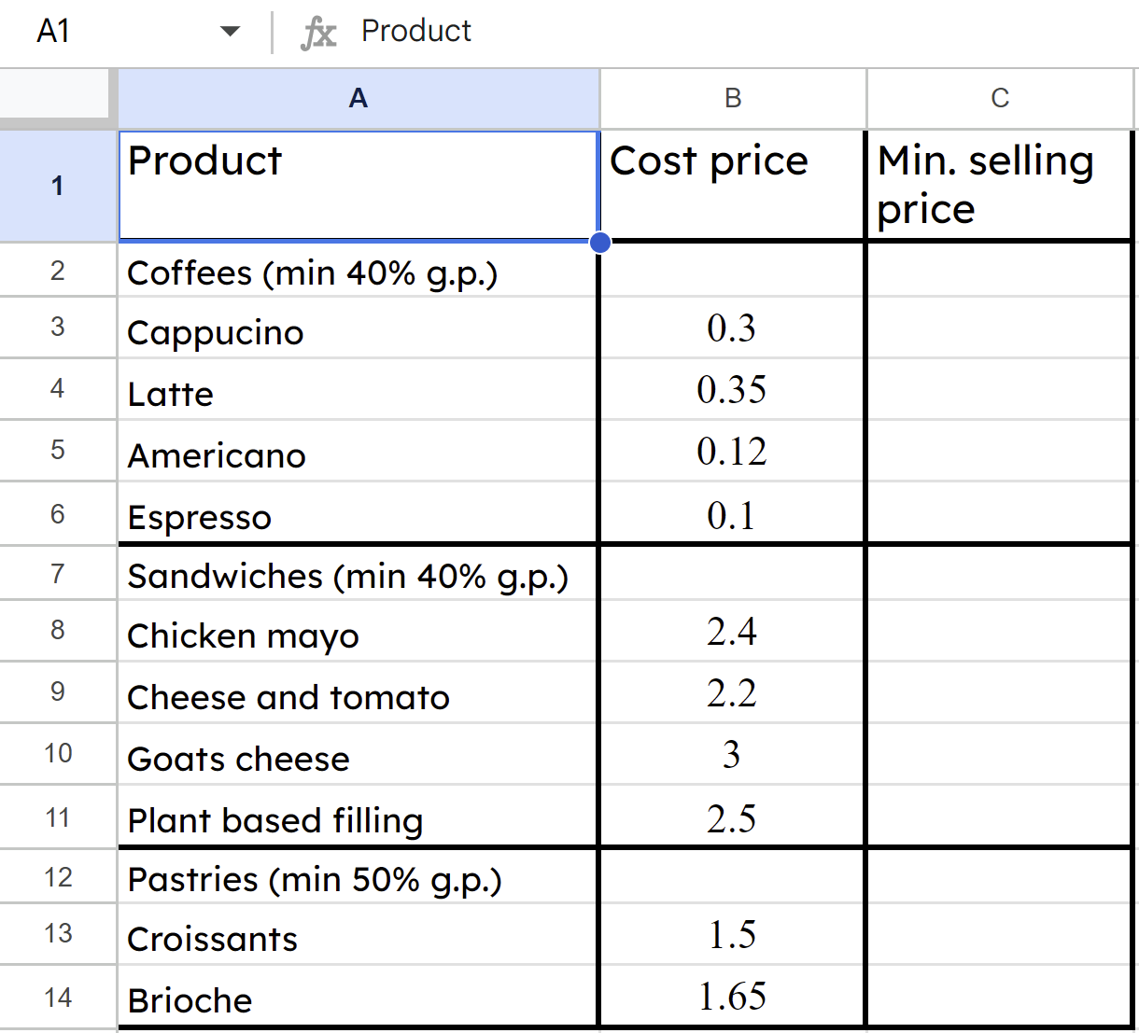
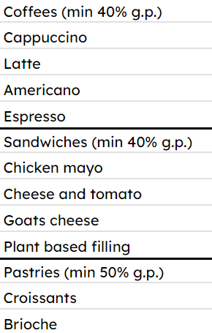
Profit in percentages
Alex and Izzy started by making a list of products and their respective cost prices.

Slide 28
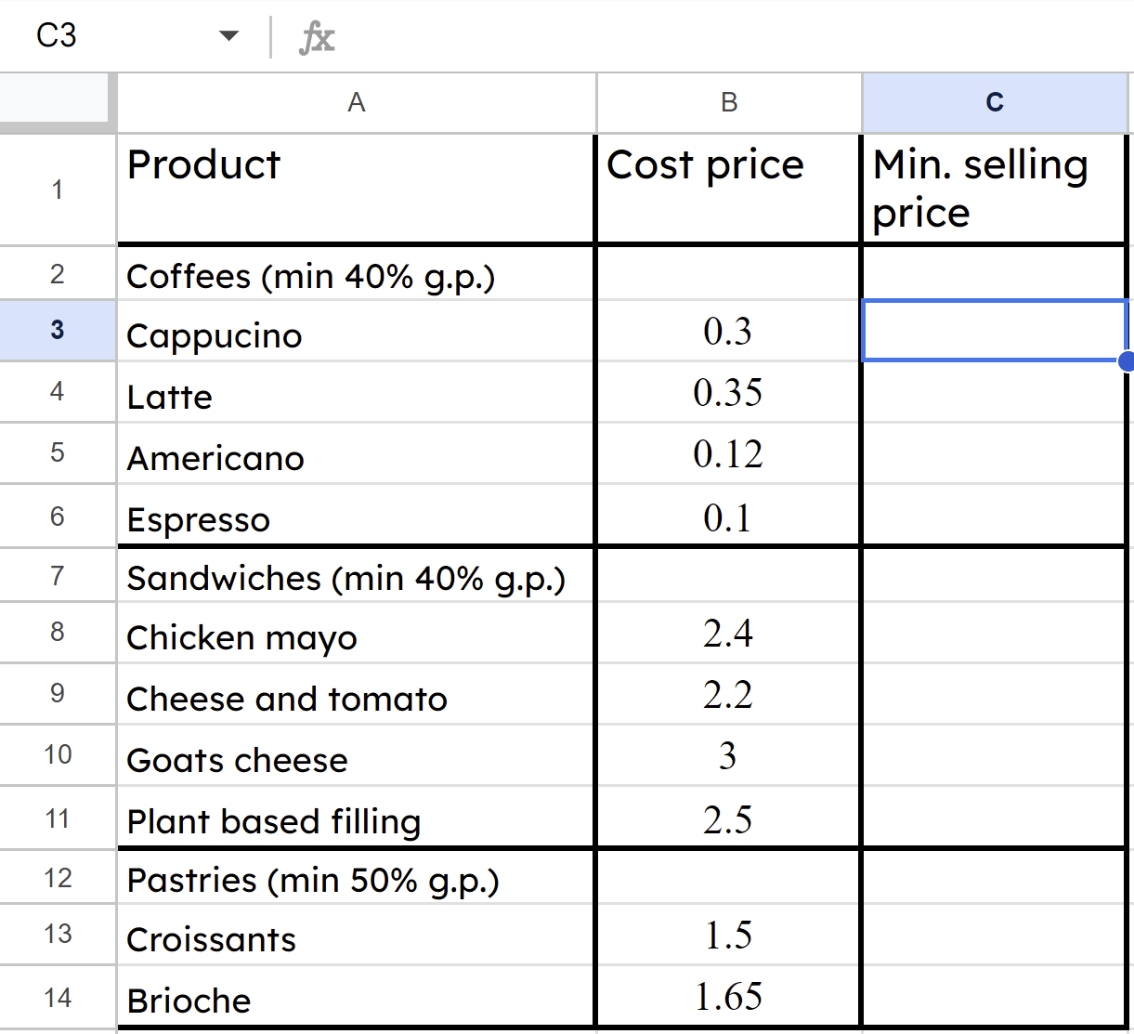
Profit in percentages
Now they can write a formula to calculate all of the minimum selling prices automatically.
They type the formula =B3/0.6 in here.
B3 is the cell which contains the cost price of this product,
B3 is the cell which contains the cost price of this product, /0.6 means ÷ 0.6

Slide 29
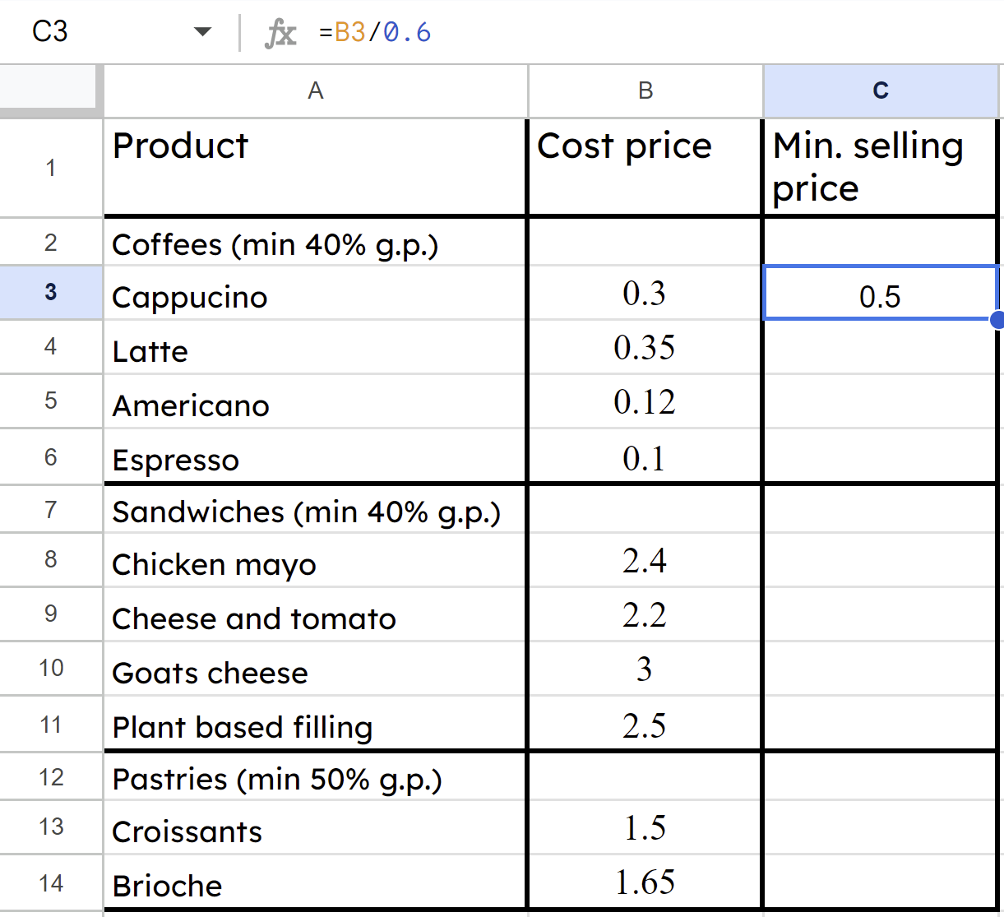
Profit in percentages
The formula =B3/0.6 doesn’t appear, the result of the calculation does. The spreadsheet calculates the minimum selling price for cappuccino as £0.50
They type a formula =B3/0.6 rather than the individual calculation =0.3/0.6 because we want to copy it across all products.

Slide 30
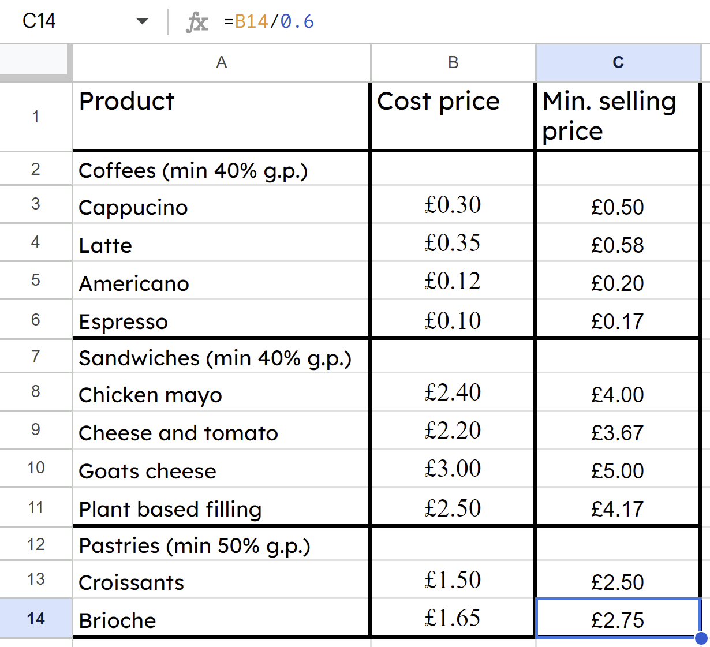
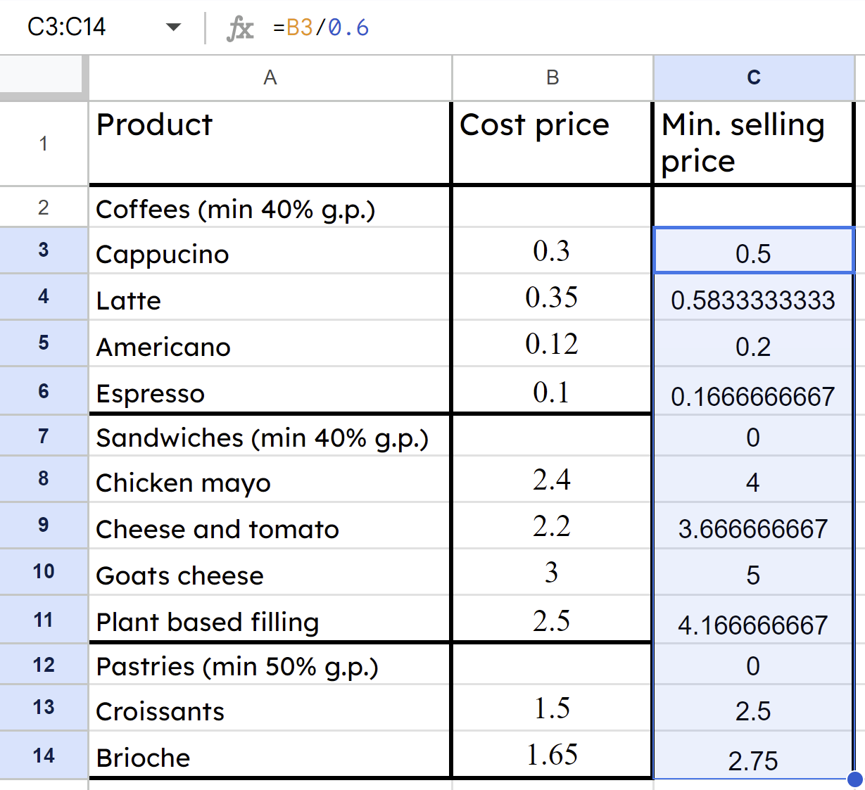
Profit in percentages
They can delete the rows they don’t need, then click on Format/Number/Currency and the results appear in a currency format.
Dragging the formula down means it is replicated in every row.

Slide 31
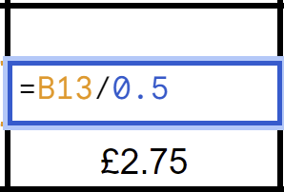
Profit in percentages
Change the 0.6 to 0.5 to reflect this target G.P. and copy the formula down.
They need to tweak the formula for any products where the target G.P. is not 40%

Slide 32
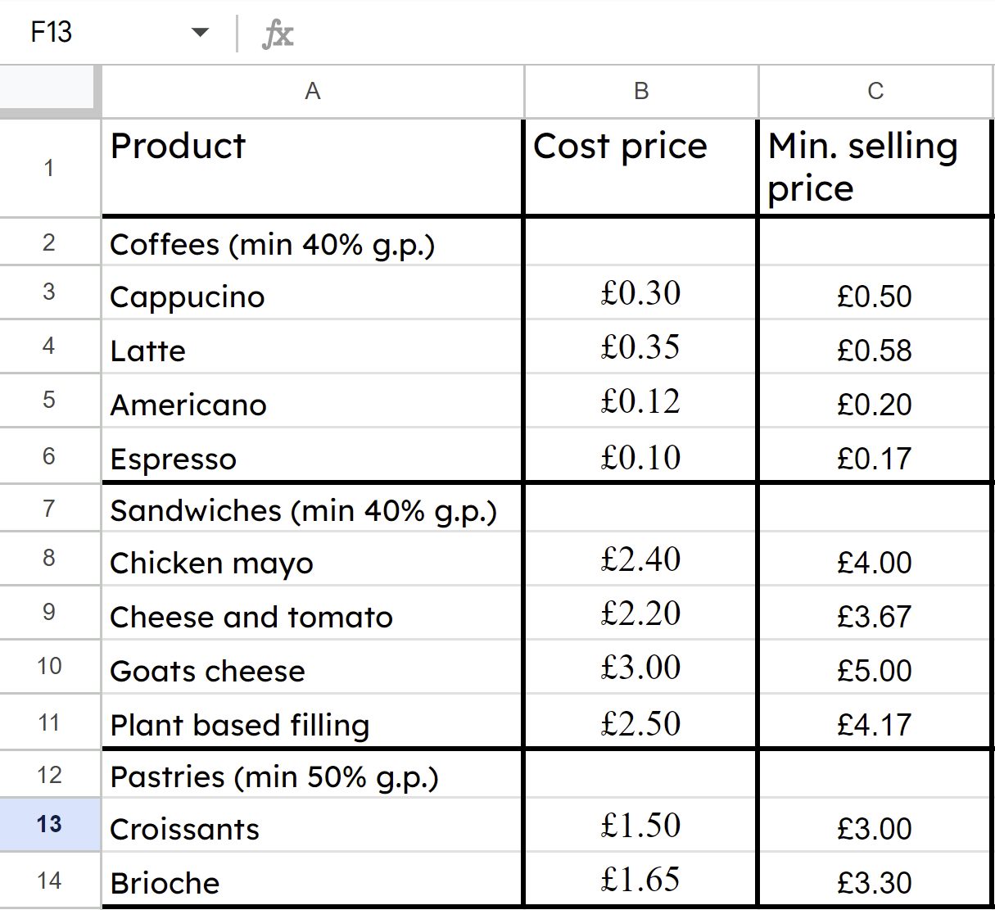
Profit in percentages
In a matter of minutes Alex and Izzy can calculate the minimum selling price across a wide variety of goods using spreadsheets and formulas.

Slide 33
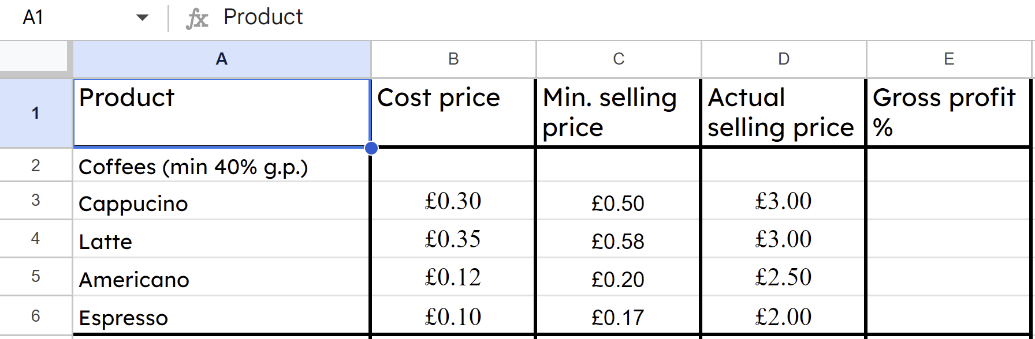
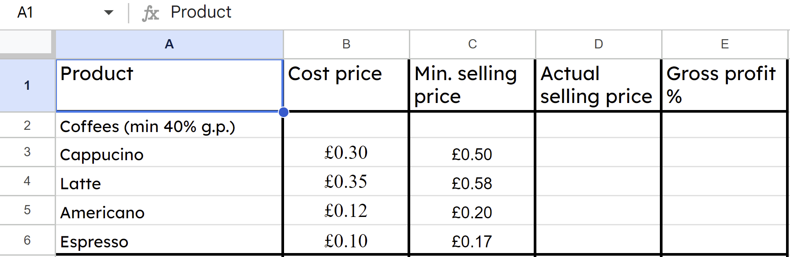
Profit in percentages
A small business is not going to sell all of their products for the minimum price calculated. They will look at the market to understand what their competitors charge and what their customers are willing to pay before deciding a selling price.

Slide 34
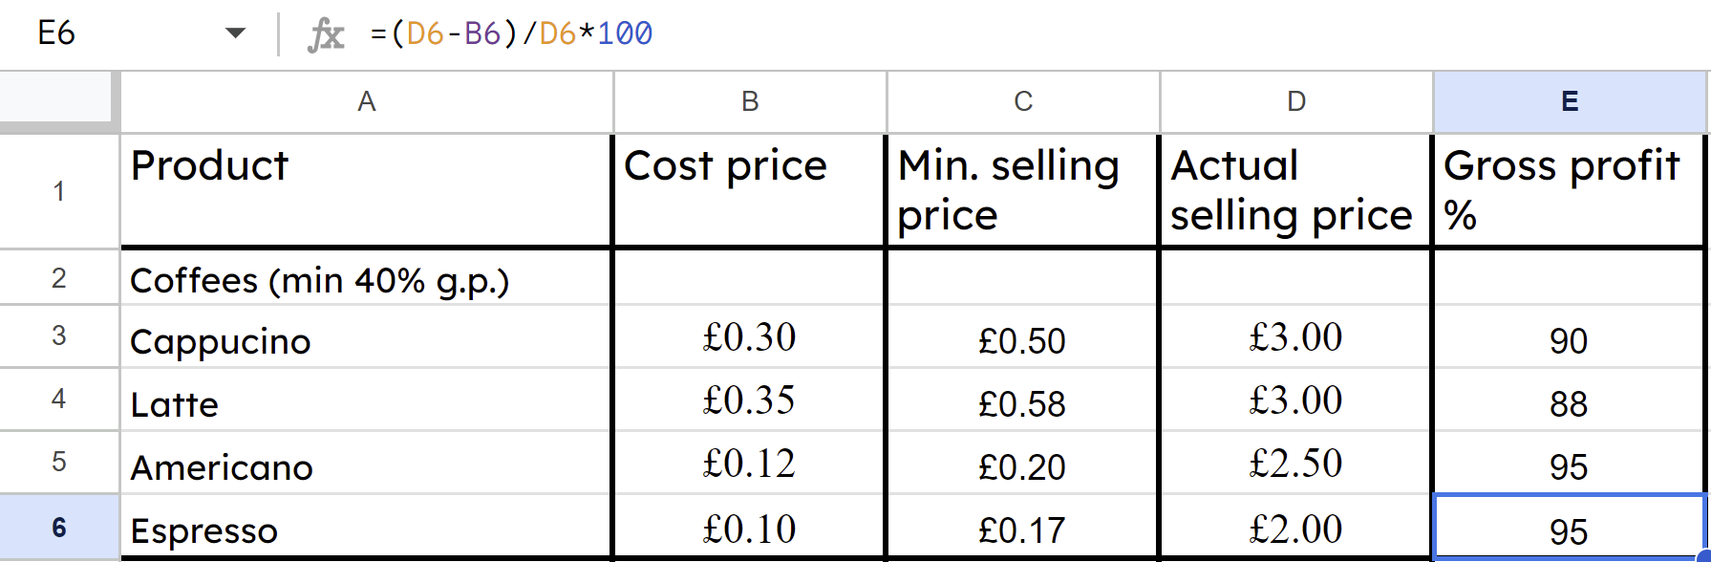

Profit in percentages
After deciding selling prices, another formula can be written in the ‘Gross profit %’ column to automatically calculate that for each product.

Slide 35
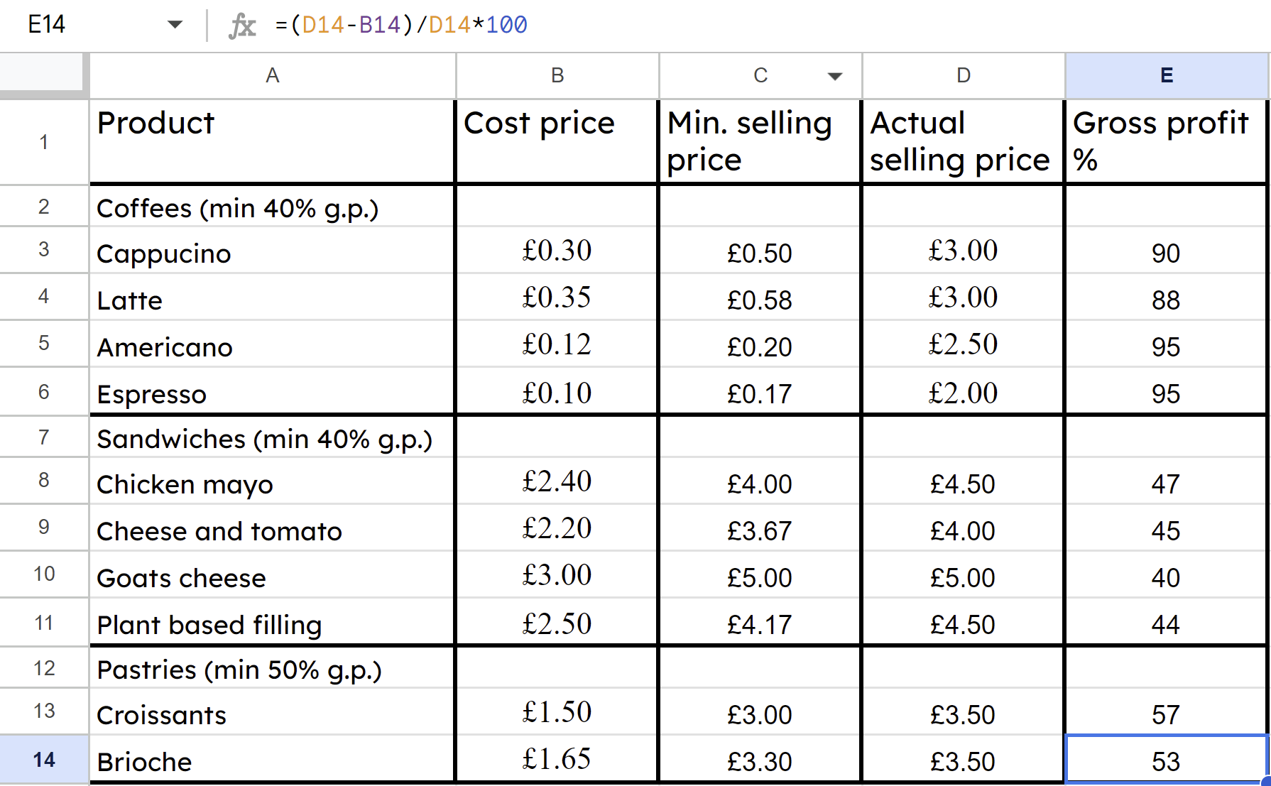
Profit in percentages
Alex and Izzy can now understand which of their products are most profitable.

Slide 36
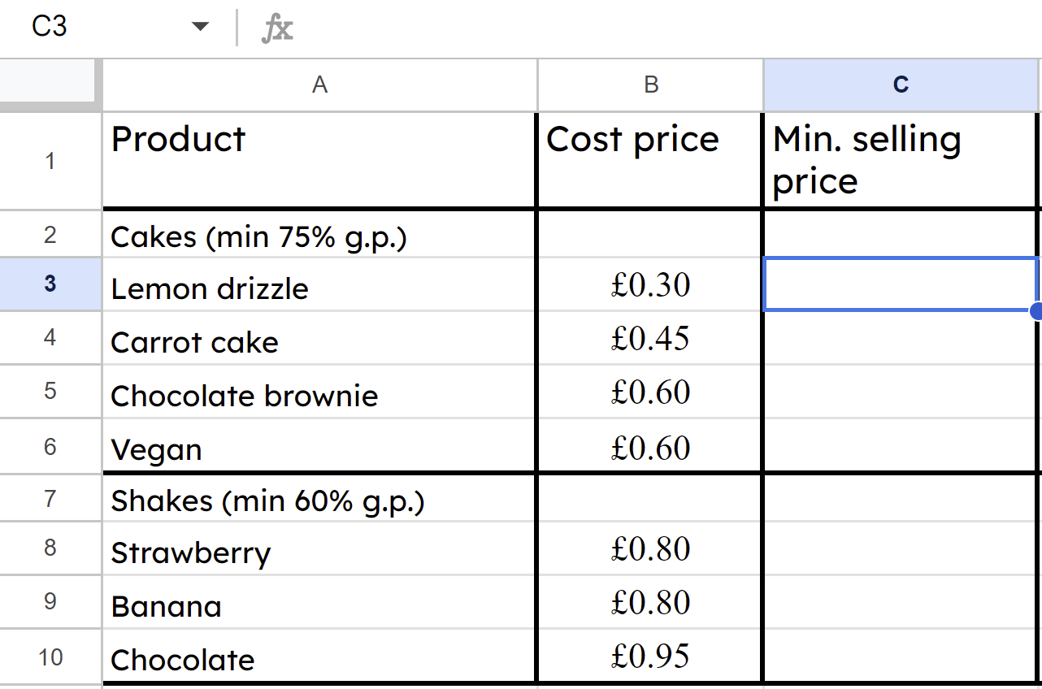


Profit in percentages
On this spreadsheet what formula should be typed into cell C3 ?
=B3/0.6
Target G.P. is 75%, not 40%
a
b
=B3/0.25
Formula must include ‘=’ sign.
c
B3/0.25

Slide 37
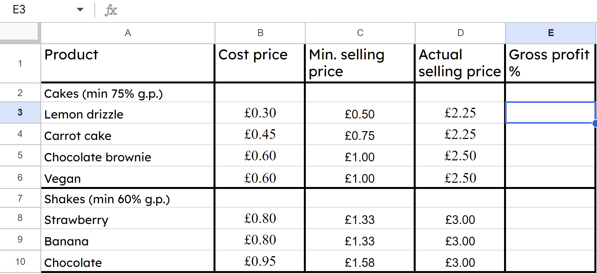
Profit in percentages
Having set selling prices what formula is typed in to cell E3 ?
a
=(D3−B3)/D3*100
b
=D3−B3/D3*100
c
=B3−D3/B3*100
Must have brackets.
Wrong order.

Slide 38
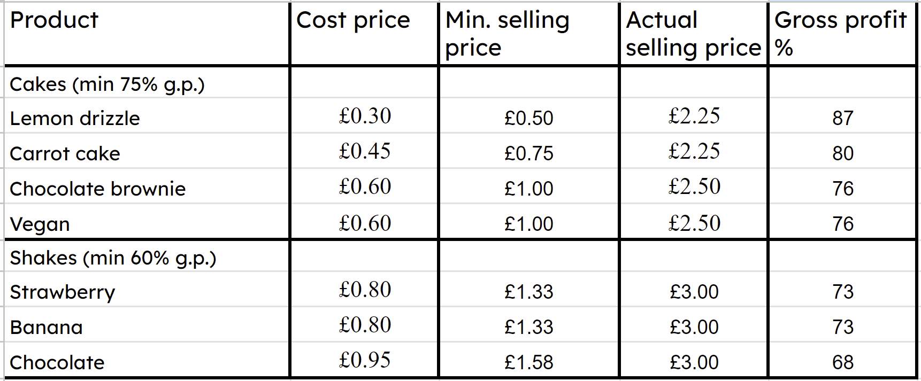
Profit in percentages
With the spreadsheet complete, which product do you think Alex and Izzy will place in the most prominent place in their cafe?
Lemon drizzle cake because it has the highest G.P. %

Slide 39
Profit in percentages
1) Fill in the blanks for this small business’ first few years of results and comment on how their profit margin is changing.
 | Gross profit | Revenue | Gross profit margin
Year one | £0 | £12 000 | 0%
Year two | £1000 | £20 000
Year three |  | £48 000 | 12.5%
Year four | £20 000 |  | 40%
Year five | £24 500 | £56 000

Slide 40
Profit in percentages
2) Calculate the gross profit margin for each of these items for this new paddleboard shop.
a) 10 ft paddleboard: Selling price £575, cost price £373.75
b) 12 ft paddleboard: Selling price £650, cost price £390
c) Carbon paddle: Selling price £110, cost price £82.50
d) Buoyancy aid: Selling price £60, cost price £34.50
e) Comment on which product is not achieving their 30% gross profit margin target and advise on what they should do.

Slide 41
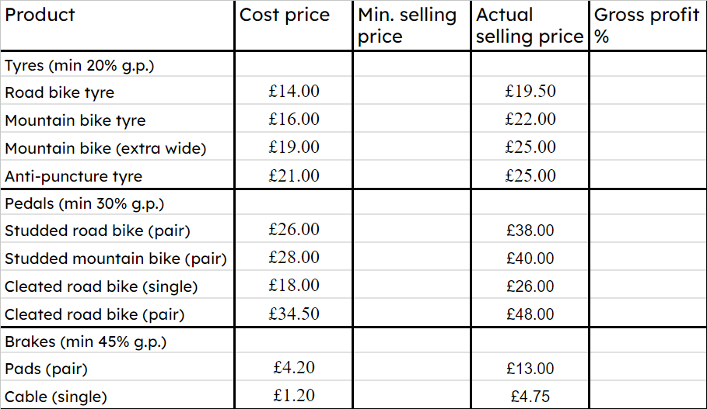
Profit in percentages
3) a) By completing a spreadsheet or otherwise, calculate the minimum selling price and gross profit margins for this bicycle shop’s products.
b) Comment on any products not achieving minimum gross profit margins.
c) Advise the business as to which products they should place most prominently in their shop.

Slide 42
Profit in percentages
1) Fill in the blanks for this small business’ first few years of results and comment on how their profit margin is changing.
 | Gross profit | Revenue | Gross profit margin
Year one | £0 | £12 000 | 0%
Year two | £1000 | £20 000
Year three |  | £48 000 | 12.5%
Year four | £20 000 |  | 40%
Year five | £24 500 | £56 000
 | Gross profit | Revenue | Gross profit margin
Year one | £0 | £12 000 | 0%
Year two | £1000 | £20 000 | 5%
Year three | £6000 | £48 000 | 12.5%
Year four | £20 000 | £50 000 | 40%
Year five | £24 500 | £56 000 | 43.75%
You might have reported, “Whilst revenue increases are slowing the gross profit margins have increased to a healthy level”.

Slide 43
Profit in percentages
2) Calculate the gross profit margin for each of these items for this new paddleboard shop.
a) 10 ft paddleboard: Selling price £575, cost price £373.75
35%
b) 12 ft paddleboard: Selling price £650, cost price £390
40%
c) Carbon paddle: Selling price £110, cost price £82.50
25%
d) Buoyancy aid: Selling price £60, cost price £34.50
42.5%
e) Comment on which product is not achieving their 30% gross profit margin target and advise on what they should do.

Slide 44
Profit in percentages
2) Calculate the gross profit margin for each of these items for this new paddleboard shop.
e) The carbon paddle is not achieving 30% G.P. The business needs to either find a cheaper supplier, raise the selling price, or stop selling this product.
c) Carbon paddle: Selling price £110, cost price £82.50
25%
e) Comment on which product is not achieving their 30% gross profit margin target and advise on what they should do.

Slide 45
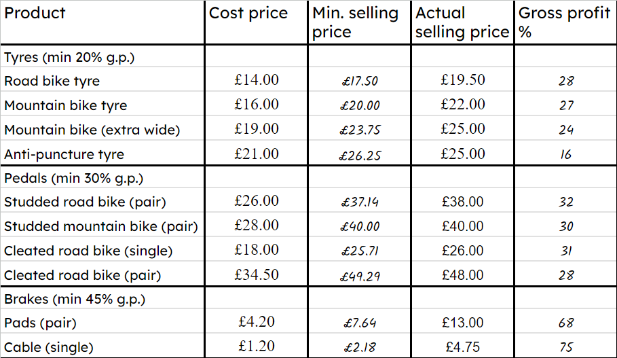
Profit in percentages
3) a) By completing a spreadsheet or otherwise, calculate the minimum selling price and gross profit margins for this bicycle shop’s products.
b) Comment on any products not achieving minimum gross profit margins.
c) Advise the business as to which products they should place most prominently in their shop.

Slide 46
Profit in percentages
3) a) By completing a spreadsheet or otherwise, calculate the minimum selling price and gross profit margins for this bicycle shop’s products.
b)
Anti-puncture tyres and cleated pedals (pair) do not achieve minimum G.P. margins.
c)
They should place brake cables most prominently in their shop.

Slide 47
Running a small business
Profit in percentages
Tracking performance

Slide 48
Tracking performance
Most small businesses use spreadsheets to track their performance.
What was this business’ greatest revenue in a month in this year?
August, £21 300
What was their lowest revenue in a month in this year?
January, £11 000
What is an average month for this business?
Mean average: £161 000 ÷ 12 = £13 417
Median average: £12 350

Slide 49
Tracking performance
Most small businesses use spreadsheets to track their performance.
Highest monthly revenue: £21 300
Range: £10 300
Lowest monthly revenue: £11 000
Mean average: £161 000 ÷ 12 = £13 417
Median average: £12 350
Understanding averages and the spread of their performance data helps a business to plan. Every business needs to forecast its sales to ensure they have the stock ready for their customers.

Slide 50
Tracking performance
Find the range and average for the year two sales of the same business.
Highest monthly revenue: £23 500
Range: £11 900
Lowest monthly revenue: £11 600
Mean average: £174 300 ÷ 12 = £14 525
Median average: £13 550

Slide 51
Tracking performance
Year one:
Year two:
Range: £10 300
Range: £11 900
Mean average: £13 417
Mean average: £14 525
Comparing year-on-year averages and spread informs a business owner about the health of their business.
The owner can conclude, “The mean average is higher therefore we sold more in year two”.
“The range is higher therefore monthly sales are more volatile, less predictable.”

Slide 52
Tracking performance
Year one:
Year two:
Range: £36 100
Range: £17 500
Mean average: £145 000
Mean average: £139 000
Make two comparisons about the year-on-year performance of this business.
You might have said, “The mean average is lower therefore they sold less in year two”.
“The range is lower therefore monthly sales are more consistent, more predictable.”

Slide 53
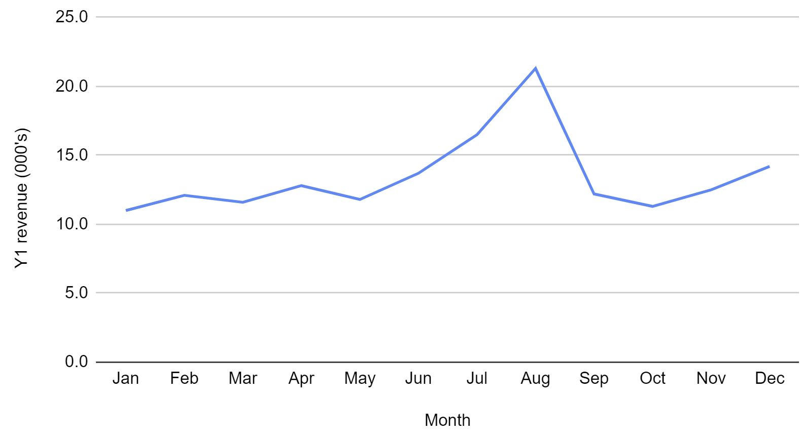
Tracking performance
One benefit of using a spreadsheet is that small business owners can easily produce graphics to more easily spot trends.
Using the insert/chart function this owner can see…
What pattern can you more easily see now?

Slide 54
Tracking performance
The graphical representation shows us that this business experiences seasonal trends.
This company might sell a product which people use most during the summer,
This company might sell a product which people use most during the summer, and gift at Christmas time.

Slide 55
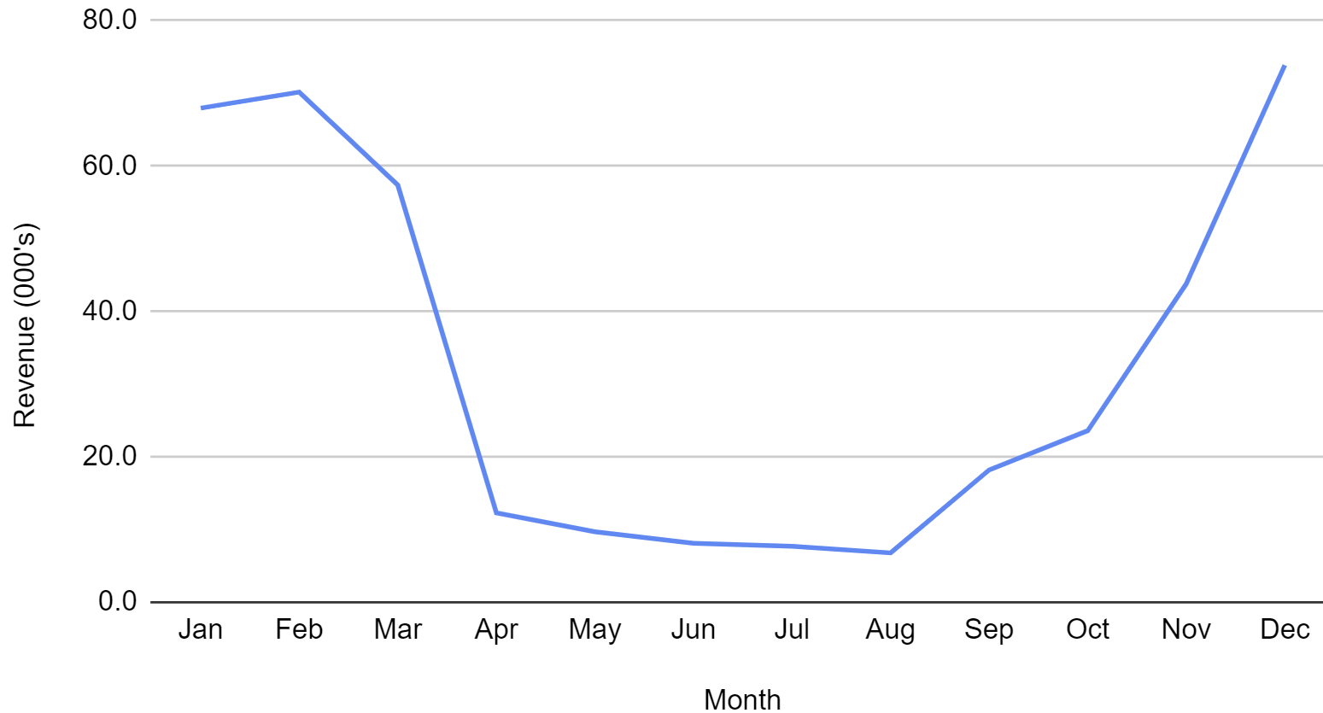
Tracking performance
What pattern can you see from the graph of this small business’ sales data?
You might have said, “A large seasonal variation with higher sales in the colder months”.

Slide 56
Tracking performance
Many small businesses experience seasonal variation. The volatility in the graph makes it difficult to see if sales are improving.
Are these sales going up or down? Can you predict what will happen next?

Slide 57
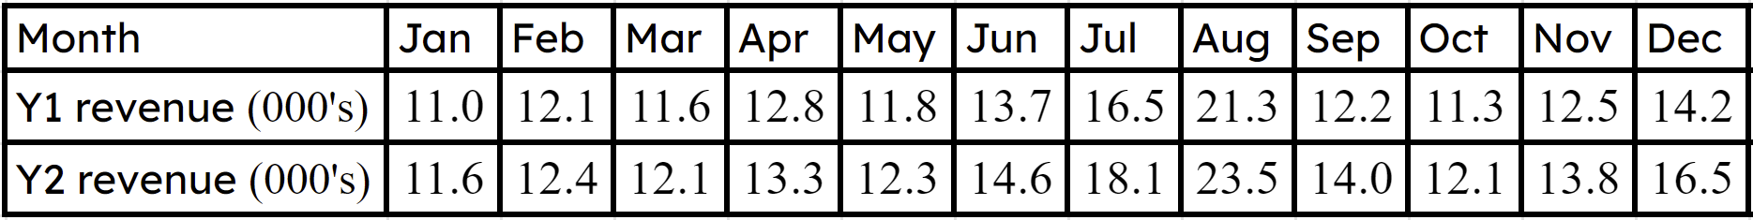
Tracking performance
A small business using a spreadsheet to track year-on-year sales in a format like this can benefit from the variety of types of chart that the software can draw for us.

Slide 58
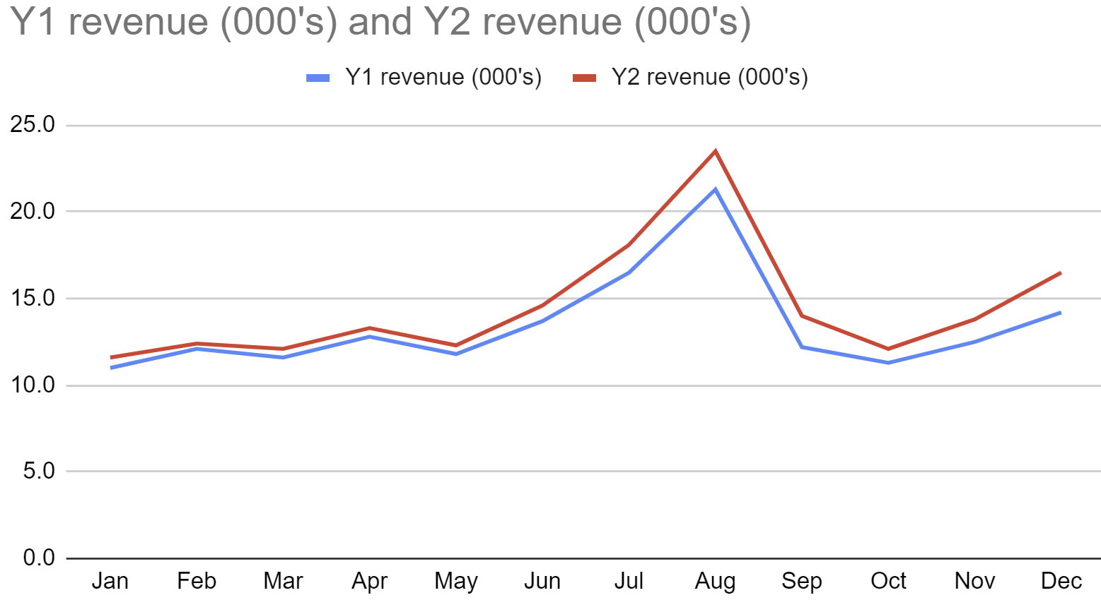
Tracking performance
You could call this a dual line graph, or a comparable line graph.
It clearly shows Y2 revenues are all above Y1’s. Year-on-year this business is improving its sales.

Slide 59
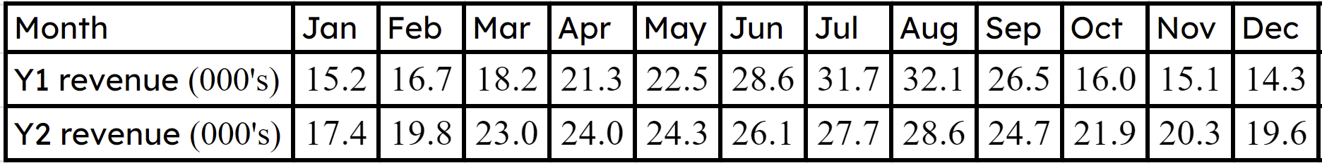
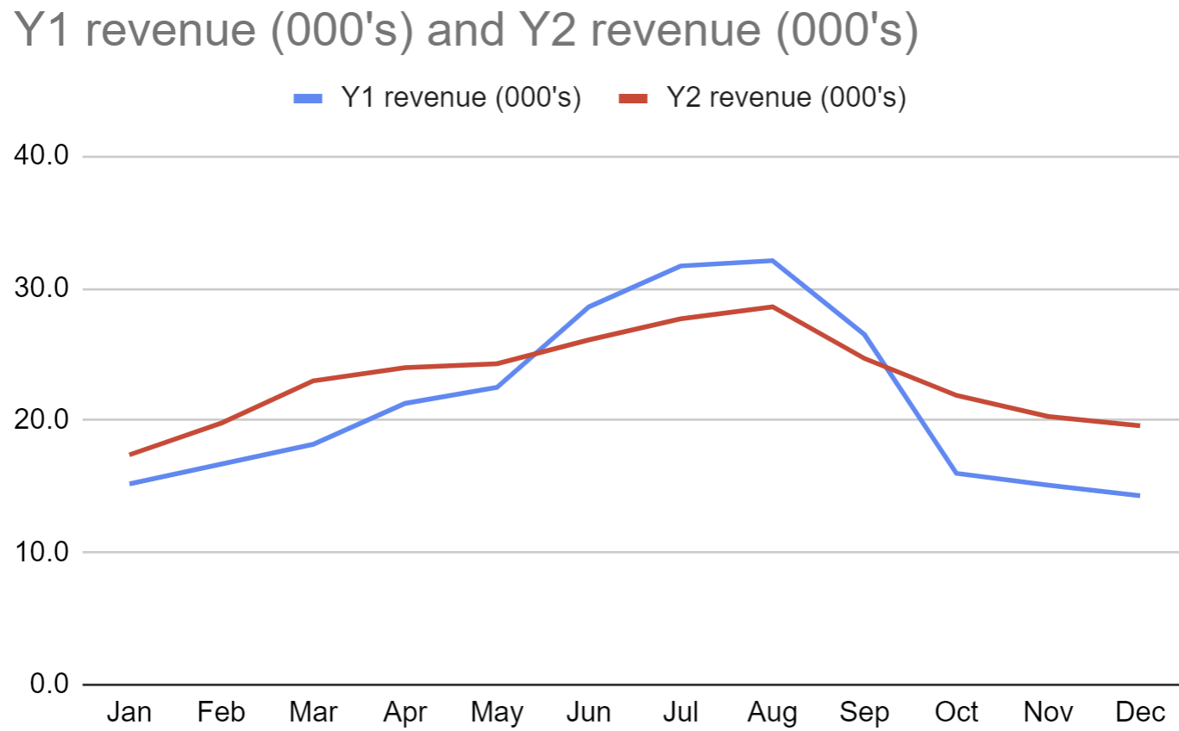
Tracking performance
What patterns do you see year-on-year in the graph of this small businesses sales?
You might have said, “There is less seasonal variation in Y2. Winter/Autumn sales are higher in Y2, whereas summer sales fell”.

Slide 60
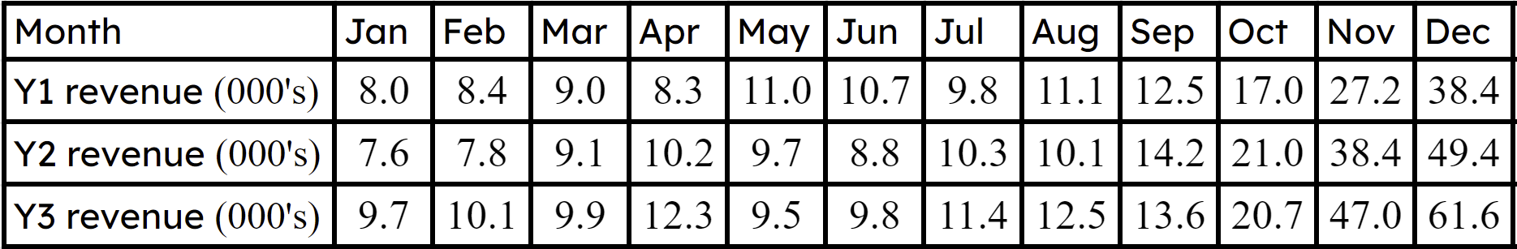
Tracking performance
1) Here are the first three years of sales for a new small business.
a) Calculate the mean and range for each year and comment on any changes year-on-year.

Slide 61
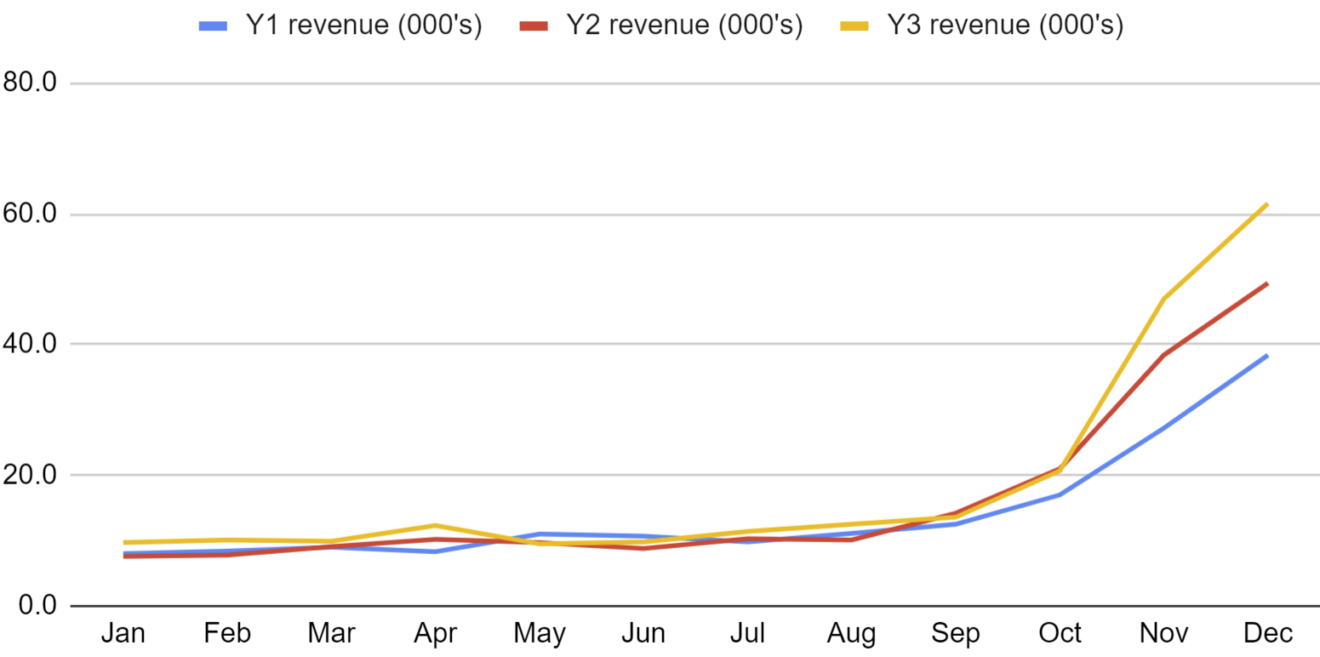
Tracking performance
b) Comment on any patterns you spot in this data.

Slide 62
Tracking performance
1) Here are the first three years of sales for a new small business.
a) Calculate the mean and range for each year and comment on any changes year-on-year.

Slide 63
Tracking performance
1) Here are the first three years of sales for a new small business.
a)
Year one:
Year two:
Year three:
Range: £30 400
Range: £41 800
Range: £52 100
Mean: £14 283
Mean: £16 383
Mean: £19 008
You might have said, “The mean is increasing so the business is selling more year-on-year. The range is increasing so the sales are becoming less consistent, less predictable month-on-month”.

Slide 64
Tracking performance
1) b)
1) c) You might have said, “The graph shows that there is a seasonal peak to the business’ sales in Nov/Dec. Their performance is level year-on-year Jan to Sept but the Oct/Nov/Dec sales are improving with each year”.

Slide 65
Running a small business
Independent business owners use percentage calculations to monitor profit over time, profit on individual items and to set selling prices. Spreadsheets are used to help small businesses understand their most profitable products.
Small businesses also use averages, spread, spreadsheets, and graphing technology to monitor performance over time.

Slide 66

© Oak National Academy 2024.
Produced in partnership with Mathematics in Education and Industry.
Licensed on the Open Government Licence v3.0, except where otherwise stated. See Oak terms and conditions.

